Slide 1



UNIT 5: Where I live
Greetings from…

Slide 2

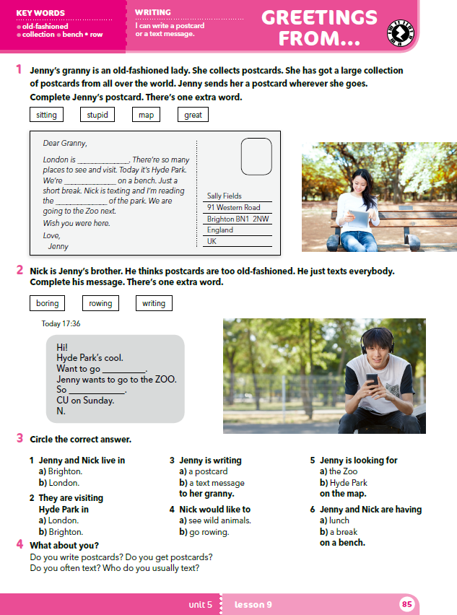

Describe the photos.
Where are they?
What are they doing?
What are they wearing?

Slide 3
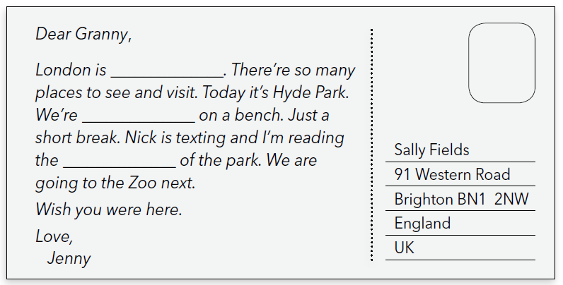
What is this?
It’s a postcard.
Have you ever received a postcard? From whom was it?
Have you ever sent someone a postcard? Whom did you send it to?

Slide 4
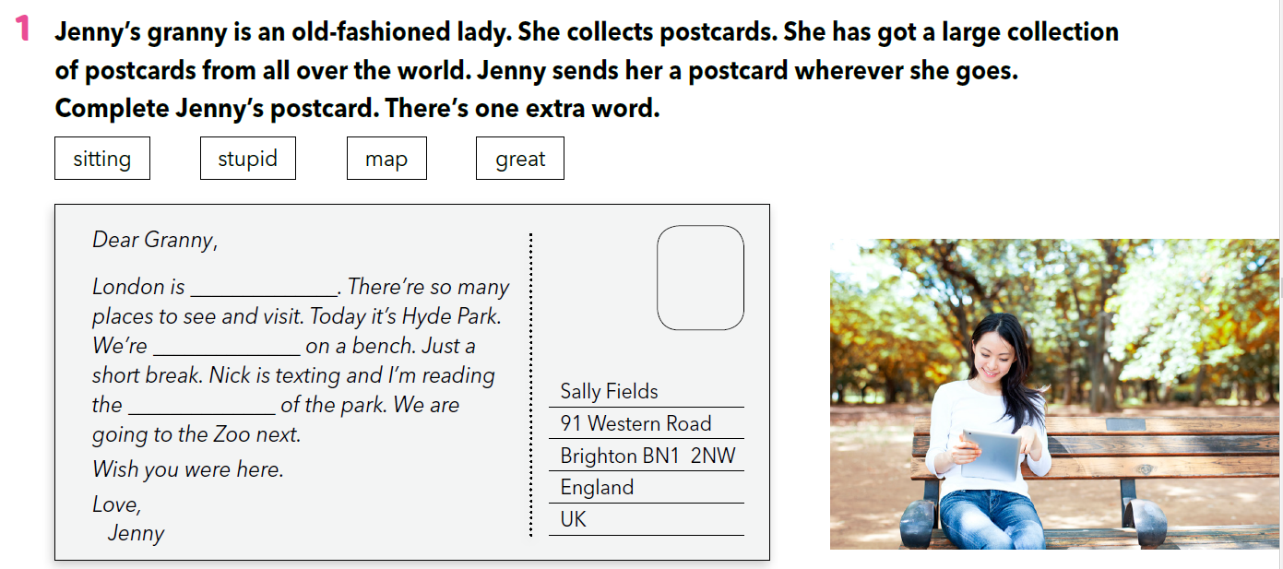
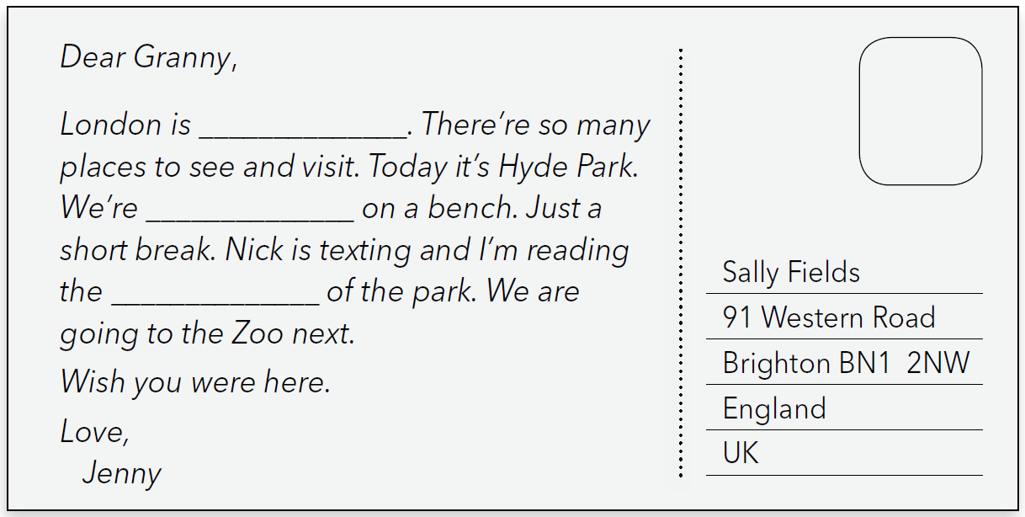
great
Check again: https://wordwall.net/play/260/227/659
sitting
map

Slide 5
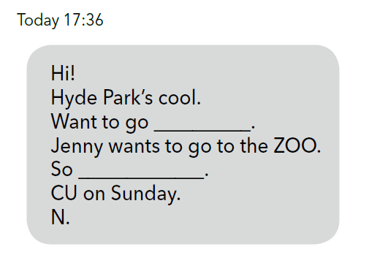
What is this?
It’s a text message.
When did you receive the last text message? From whom was it?
When did you send your last text message? Who did you text?

Slide 6
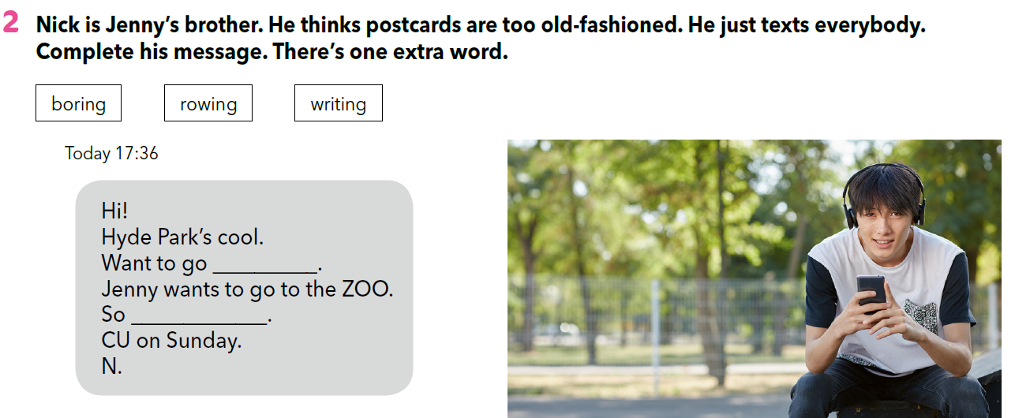
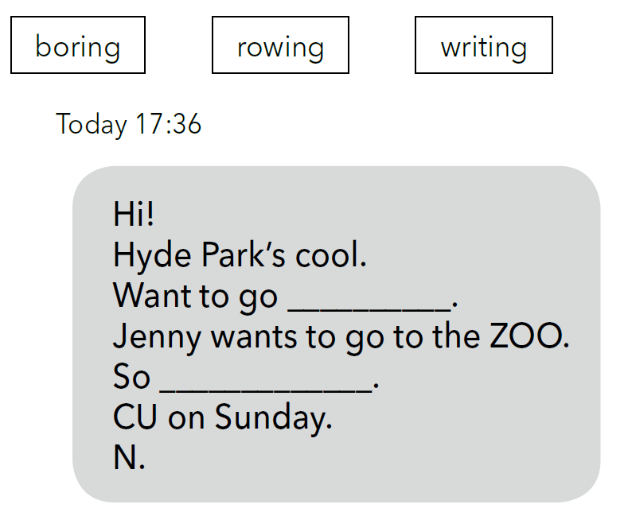
Check again: https://wordwall.net/play/260/227/659
rowing
boring

Slide 7
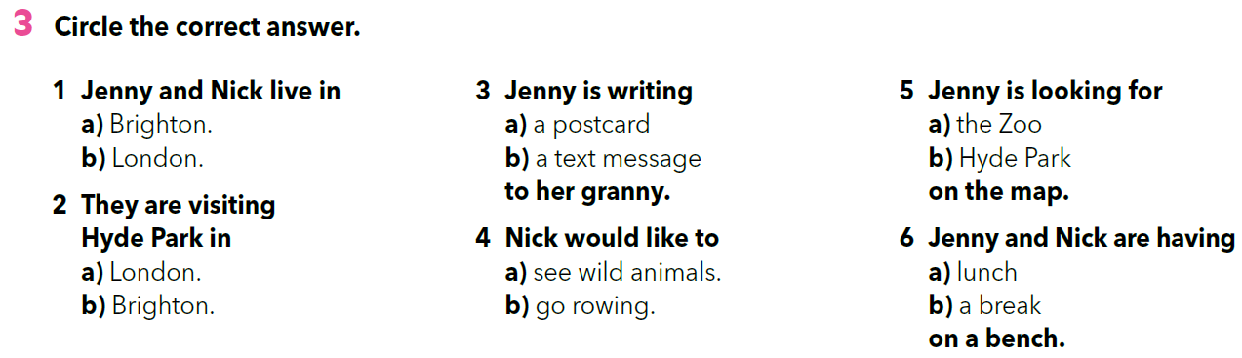

Slide 8
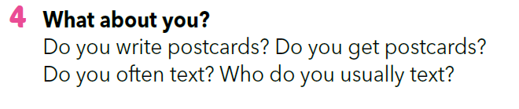
Answer the questions and discuss your answers with your partner and the rest of the class.

Slide 9
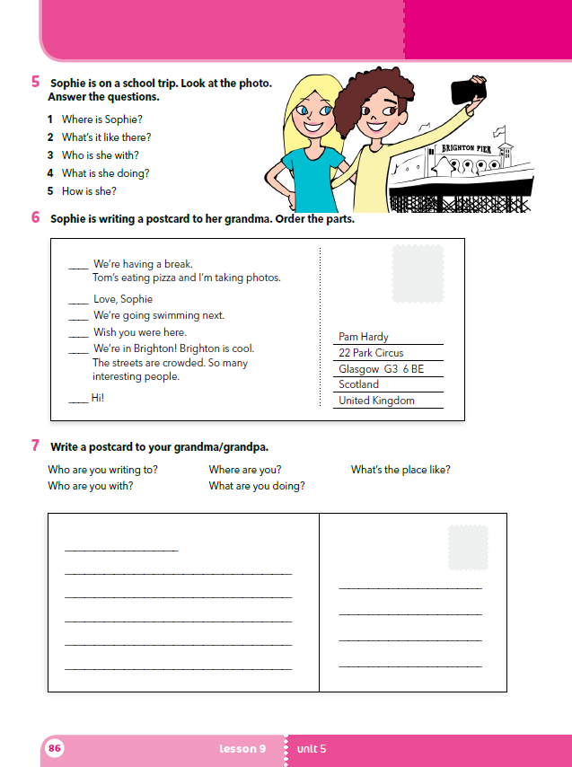
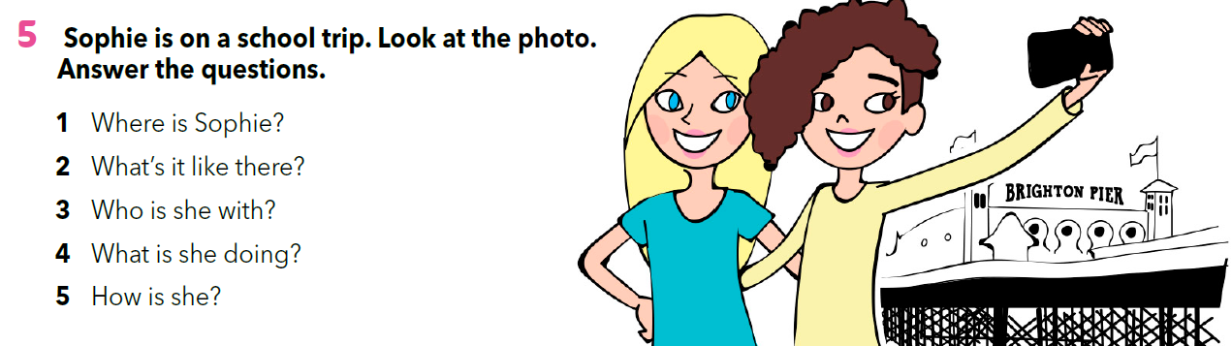

Slide 10
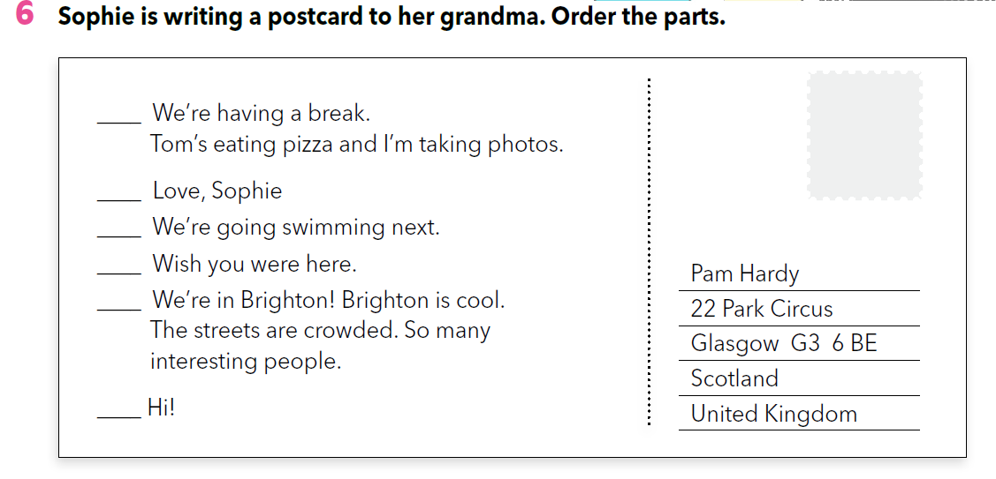
3
6
4
5
2
1

Slide 11
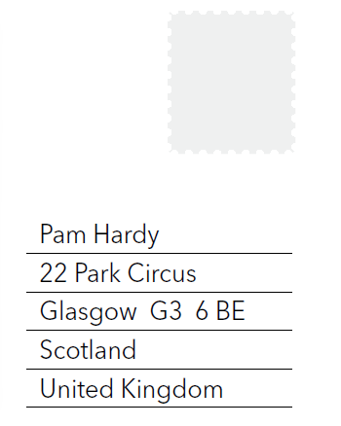
Look at the address.
How is the address written on the postcard?
What is on the first / second / third / fourth / fifth line?
Name and surname / Ime i prezime primatelja
Address / Adresa primatelja
Area code and town / Poštanski broj i naziv grada
State
Country
Država

Slide 12
